Slide 1

Features of sales prediction
Name: Lakshmi V

Slide 2
Sales prediction
One of the common methods used to predict sales is regression analysis
This method involves using historical sales data to train a model that can be predict future sales
The model can take into account factors such
1. Paste sales
2.marketing campaigns
Economic indicators to make its predictions
In data mining enable more effective sales and marketing

Slide 3
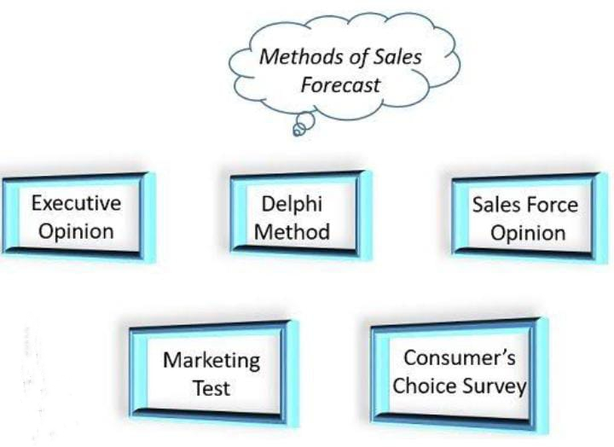
Methods of sales prediction

Slide 4

Typed of sales prediction
There are two types of sales prediction
1.short term prediction
2.long term prediction
SHORT TERM PREDICTION
Short term prediction refer to planning and budgeting cash for a short period
To plan detailed use of system
Usually use quantitative techniques
More accurate than longer term prediction
This includes : minimizing short-term debt ,idle cash ,and cash buffers

Slide 5
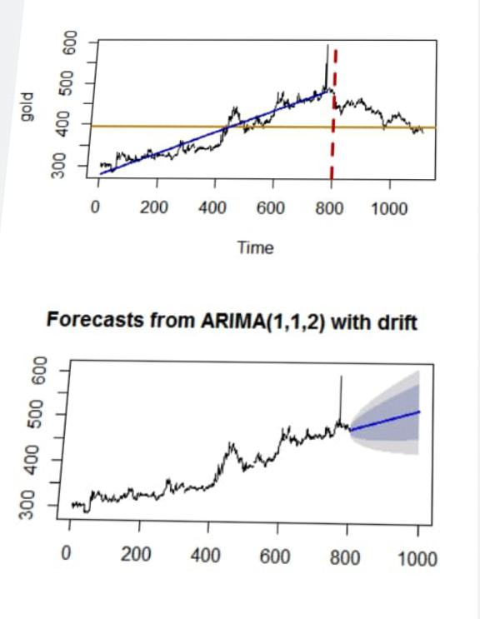
Methods of short term goals
See potential issues with cash flow management before they arise or alert you to them
Understand short term liquidity and how it may effect current borrowing or lending decisions
Consider and plan for seasonal and economic fluctuations

Slide 6
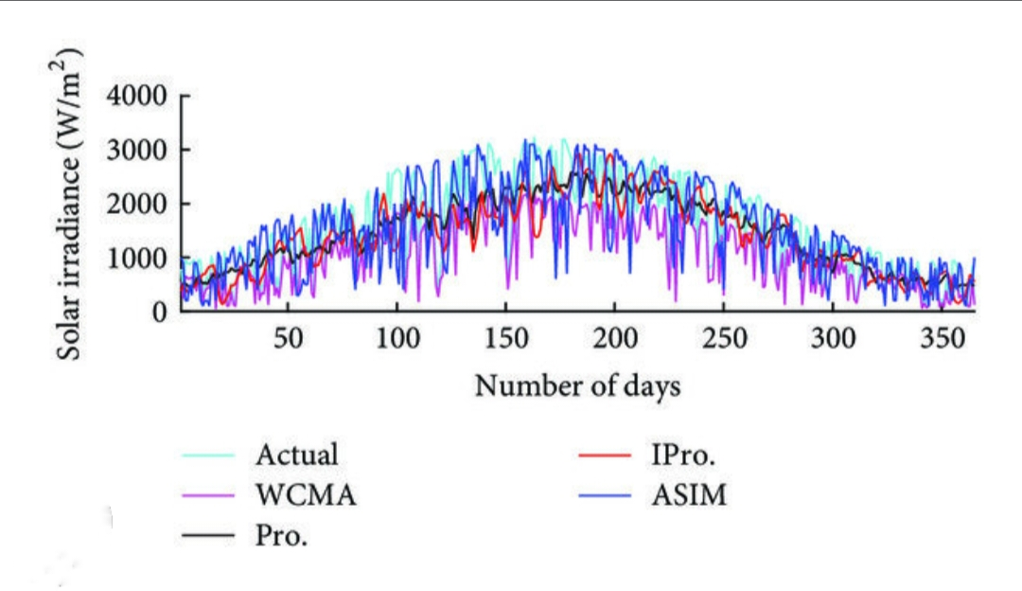
Long term prediction
Long term prediction is a method of predicting future Events ,trend, or conditions over a period of six months to five years
Long range for design of system
Deal with comprehensive issues
Support management decisions regarding planning and products ,plants and processes
Low and medium range of prediction

Slide 7
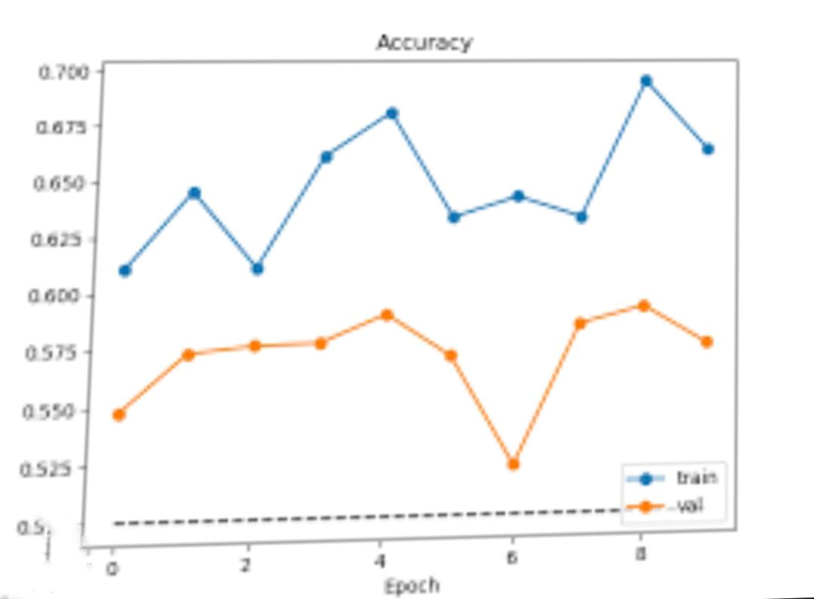
Methods of long term prediction
Determine potential credit risks
Learn how investments made today will pay off in the long run
Find out how financial decisions made today could impact you business beyond its is immediate future

Slide 8
Benefits of sales prediction
7 benefits of sales prediction
Make strategic decision
Set better goals more accurate budgeting
Better prospecting
Better hiring
resources planning
smooth external operations
Determine you sales process

Slide 9
Requirement package and installation
1.numpy
2.Pandas
3.Keras
4.Tensorflow
5.Csv
6.metpLotlib

Slide 10
Progaram
Import numpy as np import pandas as pd import matplotlib.pyplot as plt import seaborn as sns import os import scipy as sp import warnings import datetime warnings.filterwarnings(“ignore”) %matplotlib inline

Slide 11
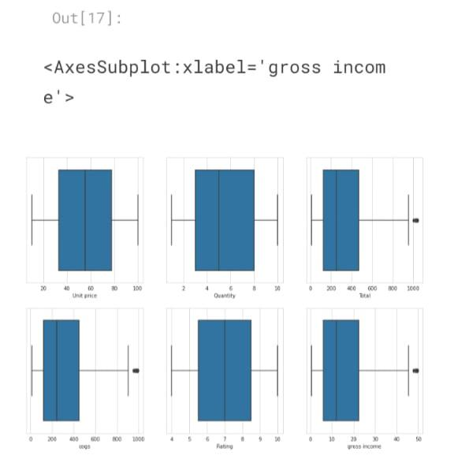
Output

Slide 12
Conclusion
Sales prediction is mainly required for the organization for business decision accurate forecasting will help the companies to enhance the market growth

